Slide 1

Deep Learning Project
Name- Aryan Vyas

Slide 2
Importing Libraries
import numpy as np
import pandas as pd
import os
from tqdm import tqdm
#For Preprocessing
import re # RegEx for removing non-letter characters
import nltk # natural language processing
nltk.download("stopwords")
from nltk.corpus import stopwords
from nltk.stem.porter import *
from nltk.sentiment.vader import SentimentIntensityAnalyzer
# For Building the model
from sklearn.model_selection import train_test_split
import tensorflow as tf
import seaborn as sns
#For data visualization
import matplotlib.pyplot as plt
import matplotlib.patches as mpatches
%matplotlib inline
pd.options.plotting.backend = "plotly"

Slide 3
Converting text into a sequence of words
def tweet_to_words(tweet):
''' Convert tweet text into a sequence of words '''
# convert to lowercase
text = tweet.lower()
# remove non letters
text = re.sub(r"[^a-zA-Z0-9]", " ", text)
# tokenize
words = text.split()
# remove stopwords
words = [w for w in words if w not in stopwords.words("english")]
# apply stemming
words = [PorterStemmer().stem(w) for w in words]
# return list
return words

Slide 4
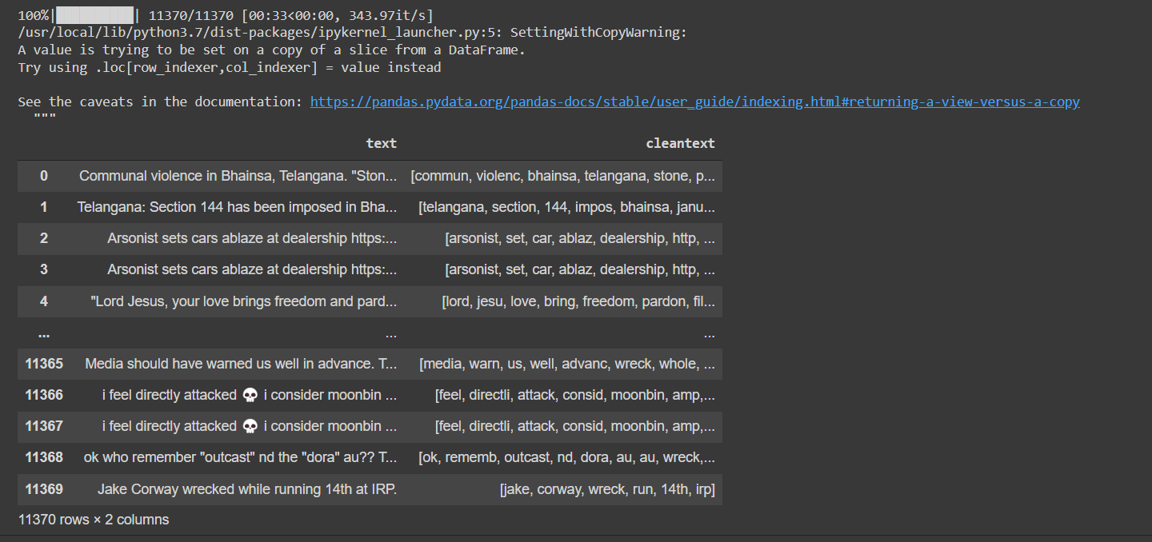

Slide 5
Cleaning the dataset
cleantext=[]
for item in tqdm(df['text']):
words=tweet_to_words(str(item))
cleantext+=[words]
df['cleantext']=cleantext
Df
def unlist(list):
words=''
for item in list:
words+=item+' '
return words

Slide 6
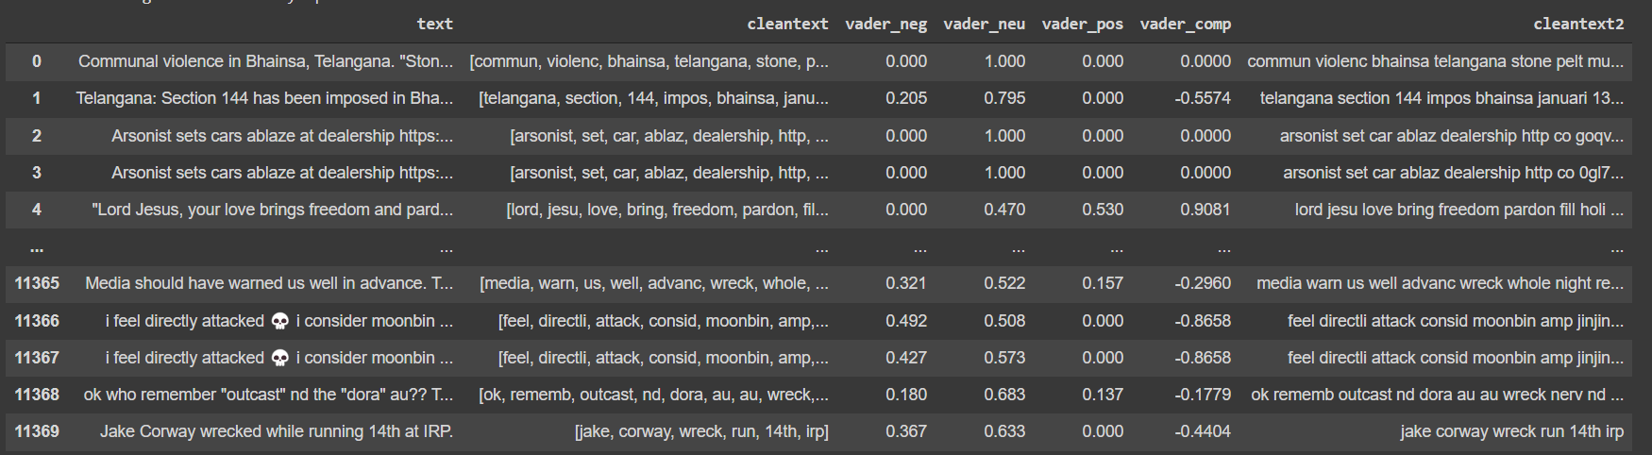
Sentiment Analysis using VADER
def compute_vader_scores(df, label):
sid = SentimentIntensityAnalyzer()
df["vader_neg"] = df[label].apply(lambda x: sid.polarity_scores(unlist(x))["neg"])
df["vader_neu"] = df[label].apply(lambda x: sid.polarity_scores(unlist(x))["neu"])
df["vader_pos"] = df[label].apply(lambda x: sid.polarity_scores(unlist(x))["pos"])
df["vader_comp"] = df[label].apply(lambda x: sid.polarity_scores(unlist(x))["compound"])
df['cleantext2'] = df[label].apply(lambda x: unlist(x))
return df
df2 = compute_vader_scores(df,'cleantext')
df2

Slide 7
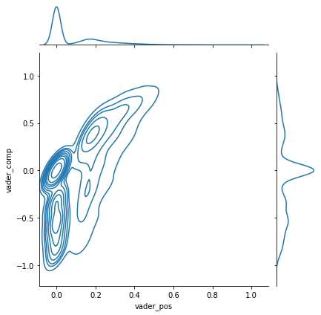
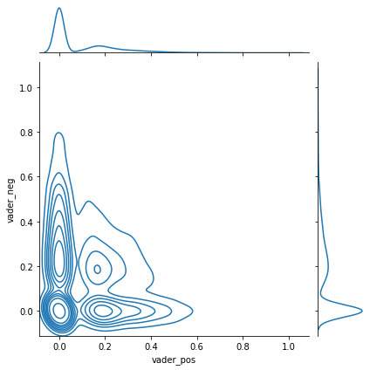

Slide 8
Tokenization
from tensorflow.keras.preprocessing.text import Tokenizer
from tensorflow.keras.preprocessing.sequence import pad_sequences
max_words = 5000
max_len=50
def tokenize_pad_sequences(text):
'''
This function tokenize the input text into sequnences of intergers and then
pad each sequence to the same length
'''
# Text tokenization
tokenizer = Tokenizer(num_words=max_words, lower=True, split=' ')
tokenizer.fit_on_texts(text)
X = tokenizer.texts_to_sequences(text)
X = pad_sequences(X, padding='post', maxlen=max_len)
return X, tokenizer
print('Before Tokenization & Padding \n', df['cleantext2'][0])
X, tokenizer = tokenize_pad_sequences(df['cleantext2'])
print('After Tokenization & Padding \n', X[0])

Slide 9
Splitting the dataset
Test, Train and Validation
y = pd.get_dummies(df['class'])
X_train, X_test, y_train, y_test = train_test_split(X, y, test_size=0.2, random_state=1)
X_train, X_val, y_train, y_val = train_test_split(X_train, y_train, test_size=0.25, random_state=1)
print('Train Set: ', X_train.shape, y_train.shape)
print('Validation Set: ', X_val.shape, y_val.shape)
print('Test Set: ', X_test.shape, y_test.shape)
Train Set: (6822, 50) (6822, 3)
Validation Set: (2274, 50) (2274, 3)
Test Set: (2274, 50) (2274, 3)

Slide 10
Building the Model - Tensorflow
from tensorflow.keras.models import Sequential
from tensorflow.keras.layers import Embedding, Conv1D, MaxPooling1D, Bidirectional, LSTM, Dense, Dropout
from tensorflow.keras.metrics import Precision, Recall
from tensorflow.keras.optimizers import SGD
from tensorflow.keras.optimizers import RMSprop
from tensorflow.keras import datasets
from tensorflow.keras.callbacks import LearningRateScheduler
from tensorflow.keras.callbacks import History
from tensorflow.keras import losses
sgd = SGD(lr=learning_rate, momentum=momentum, decay=decay_rate, nesterov=False)
# Build model
model= Sequential()
model.add(Embedding(vocab_size, embedding_size, input_length=max_len))
model.add(Conv1D(filters=32, kernel_size=1, padding='same', activation='relu'))
model.add(MaxPooling1D(pool_size=2))
model.add(Bidirectional(LSTM(32)))
model.add(Dropout(0.4))
model.add(Dense(3, activation='softmax'))

Slide 11
model.compile(loss='categorical_crossentropy', optimizer=sgd, metrics=['accuracy', Precision(), Recall()])
history = model.fit(X_train,y_train,validation_data=(X_val, y_val),batch_size=64,epochs=epochs,verbose=1)
df2 = compute_vader_scores(df,'cleantext')
df2
Accuracy : 0.4178
Precision : 0.6849
Recall : 0.0220
F1 Score : 0.0426

Slide 12
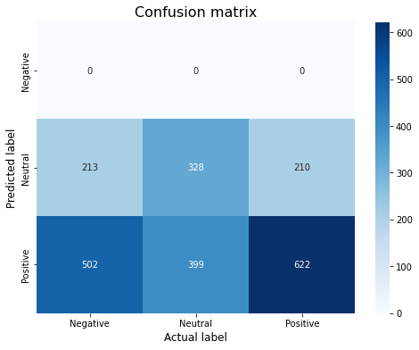
Confusion Matrix
from sklearn.metrics import confusion_matrix
def plot_confusion_matrix(model, X_test, y_test):
'''Function to plot confusion matrix for the passed model and the data'''
sentiment_classes = ['Negative','Neutral', 'Positive']
# use model to do the prediction
y_pred = model.predict(X_test)
# compute confusion matrix
cm = confusion_matrix(np.argmax(y_pred, axis=1),np.argmax(np.array(y_test),axis=1))
print(pd.Series(np.argmax(np.array(y_test),axis=1)).value_counts())
print(pd.Series(np.argmax(y_pred, axis=1)).value_counts())
# plot confusion matrix
plt.figure(figsize=(8,6))
sns.heatmap(cm, cmap=plt.cm.Blues, annot=True, fmt='d',
xticklabels=sentiment_classes,
yticklabels=sentiment_classes)
plt.title('Confusion matrix', fontsize=16)
plt.xlabel('Actual label', fontsize=12)
plt.ylabel('Predicted label', fontsize=12)
plot_confusion_matrix(model, X_test, y_test)

Slide 13
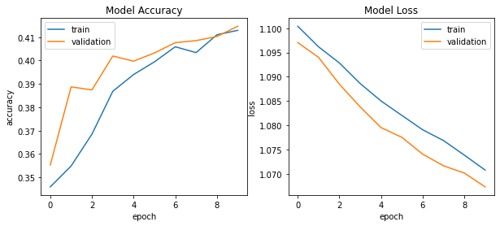
Accuracy and epoch
def plot_training_hist(history):
'''Function to plot history for accuracy and loss'''
fig, ax = plt.subplots(1,2, figsize=(10,4))
# first plot
ax[0].plot(history.history['accuracy'])
ax[0].plot(history.history['val_accuracy'])
ax[0].set_title('Model Accuracy')
ax[0].set_xlabel('epoch')
ax[0].set_ylabel('accuracy')
ax[0].legend(['train', 'validation'], loc='best')
# second plot
ax[1].plot(history.history['loss'])
ax[1].plot(history.history['val_loss'])
ax[1].set_title('Model Loss')
ax[1].set_xlabel('epoch')
ax[1].set_ylabel('loss')
ax[1].legend(['train', 'validation'], loc='best')
plot_training_hist(history)

Slide 14
Changing layers and comparing accuracy
def RNN():
inputs = Input(name='inputs',shape=[max_len])
layer = Embedding(max_words,50,input_length=max_len)(inputs)
layer = LSTM(64)(layer)
layer = Dense(256,name='FC1')(layer)
layer = Activation('relu')(layer)
layer = Dropout(0.5)(layer)
layer = Dense(1,name='out_layer')(layer)
layer = Activation('sigmoid')(layer)
model = Model(inputs=inputs,outputs=layer)
return model
model = RNN()
model.summary()
model.compile(loss='binary_crossentropy',optimizer=RMSprop(),metrics=['accuracy’])
test_sequences = tok.texts_to_sequences(Test_X)
test_sequences_matrix = sequence.pad_sequences(test_sequences,maxlen=max_len)
print('Test set\n Loss: {:0.3f}\n Accuracy: {:0.3f}'.format(accr[0],accr[1]))
Test set Loss: 0.325 Accuracy: 0.872

Slide 15
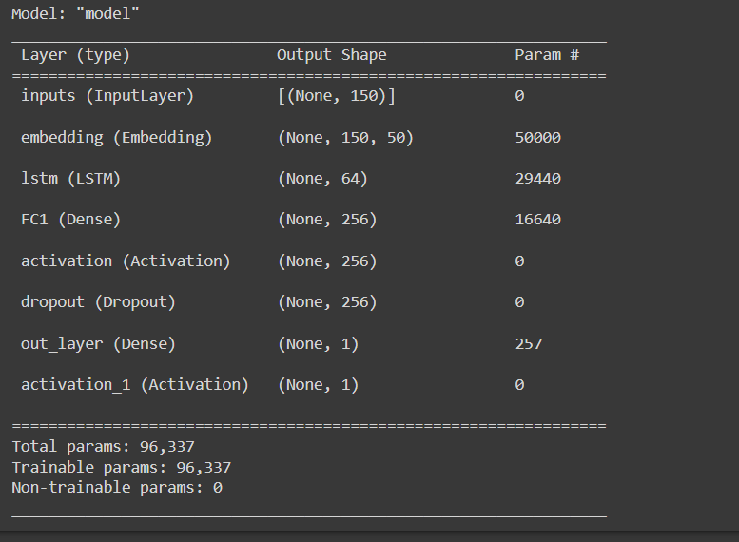

Slide 16
def RNN():
inputs = Input(name='inputs',shape=[max_len])
layer = Embedding(max_words,50,input_length=max_len)(inputs)
layer = LSTM(70)(layer)
layer = Dense(406,name='FC1')(layer)
layer = Activation('relu')(layer)
layer = Dropout(0.2)(layer)
layer = Dense(1,name='out_layer')(layer)
layer = Activation('sigmoid')(layer)
model = Model(inputs=inputs,outputs=layer)
return model
model = RNN()
model.summary()
model.compile(loss='binary_crossentropy',optimizer=RMSprop(),metrics=['accuracy'])
test_sequences = tok.texts_to_sequences(Test_X)
test_sequences_matrix = sequence.pad_sequences(test_sequences,maxlen=max_len)
print('Test set\n Loss: {:0.3f}\n Accuracy: {:0.3f}'.format(accr[0],accr[1]))
Test set Loss: 0.338 Accuracy: 0.859

Slide 17
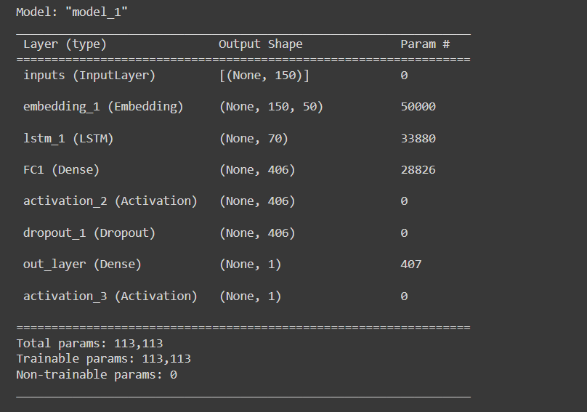

Slide 18
Thank You.

